Slide 1
Dell Software Group "IT System Management Introduction” Lab Course
Russell Chen
Team Lead of Software Development

Slide 2
Agenda
Understanding APM
Overall architecture and Java Agent
Model & Metric
Technique: Java Bytecode, Instrument, Servlet, JDBC, JMX&MXBeans
Resources
Demo
Q&A

Slide 3
Understand Application Performance Monitoring
Focus on making sure software application programs perform as expected.
Provide end user experience data from the user through the distributed application components.
Be able to monitor and trace transactions across tiers of the application.
Detect performance deviations of application components.
Notes:
http://blogs.gartner.com/jonah-kowall/2014/02/14/application-monitoring-is-not-application-performance-monitoring-apm/

Slide 4
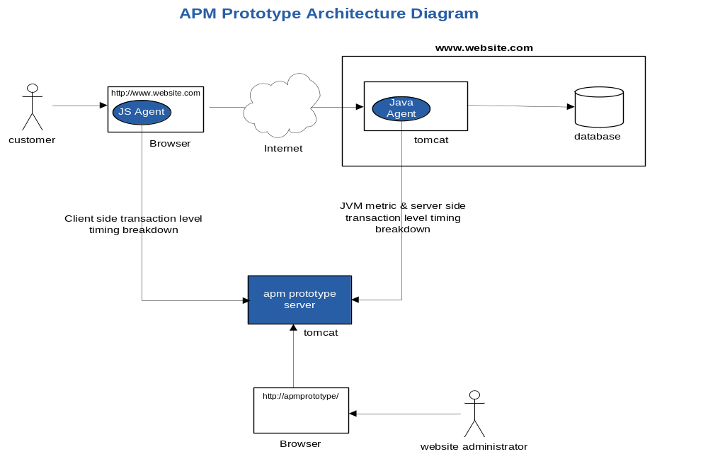
Overall architecture and Java Agent
Overall architecture

Slide 5
Overall architecture and Java Agent
Java Agent
Java Agent is used to get two kinds of information:
  Get the server side request processing time and database accessing time
    Instrument Servlet service methods
    Instrument JDBC update and query methods
  Get JVM performance
    Query MXBeans using JMX
  Send collected data to APM server
    Send JVM metric & Server side transaction level timing breakdown data
    to APM Server for monitoring

Slide 6
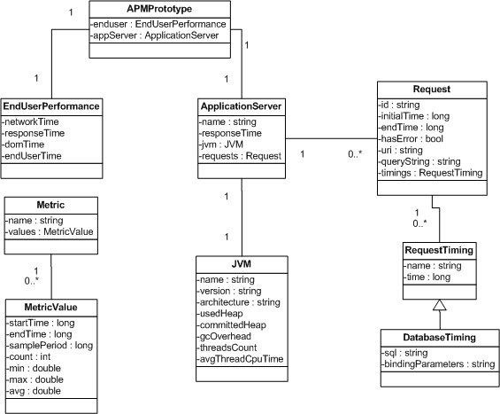
Model & Metric
Model

Slide 7
Model & Metric
Metric
  An object represents a serial data over timeline
  Can be rolled up
  Can be displayed in the chart with its historical data

Slide 8
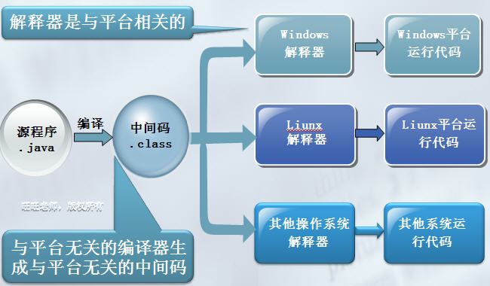
Technique used in this project
Java bytecode

Slide 9
Technique used in this project
Instrument
Instrumentation refers to an ability to monitor or measure the level of a product's
performance, to diagnose errors and to write trace information.
This technique has been applied to monitor applications written in different
languages such as Java, .NET, Ruby, JS etc.
Java instrumentation is a new feature from Java 5. It provides services that allow
Java programming language agents to instrument programs running on the JVM.
The mechanism for instrumentation is modification of the byte-codes of methods.

Slide 10
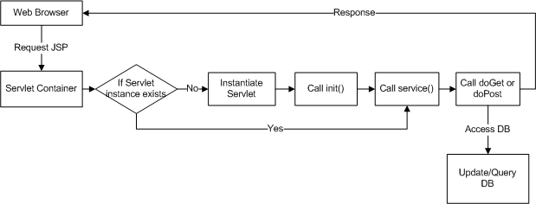
Technique used in this project
Servlet
  Servlet is the key component of J2EE to process web requests, and response
  users with dynamic contents.

Slide 11
Technique used in this project
JDBC
  JDBC(Java Data Base Connectivity) is an API for the Java programming language
  that defines how a client may access different databases in a consistent way.
  It provides a set of methods for querying and updating data in a database to
  simplify the DB programing.

Slide 12
Technique used in this project
JMX & MXBeans
  The JMX technology provides a simple, standard way of managing resources
  such as applications, devices, and services. The JMX specification defines the
  architecture, design patterns, APIs, and services in the Java programming
  language for management and monitoring of applications and networks.
  The platform MXBeans are a set of MXBeans that is provided with the Java SE
  platform for monitoring and managing the Java VM and other components of
  the Java Runtime Environment (JRE)
  java -jar jdk_home/demo/jfc/Notepad/Notepad.jar
  jconsole

Slide 13
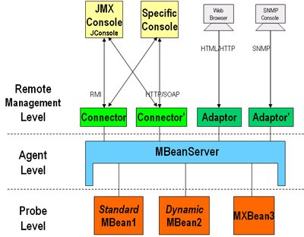
Technique used in this project
JMX & MXBeans

Slide 14
Resources
Java Instrument
http://docs.oracle.com/javase/7/docs/technotes/guides/instrumentation/index.html
http://www.ibm.com/developerworks/cn/java/j-lo-jse61/
http://blog.csdn.net/pwlazy/article/details/510974
Javassist
http://www.csg.ci.i.u-tokyo.ac.jp/~chiba/javassist/
http://blog.csdn.net/yadandan520_ya/article/details/3956867
HttpClient
http://hc.apache.org/httpclient-3.x/tutorial.html
JMX & MXBeans
http://docs.oracle.com/javase/tutorial/jmx/index.html
Ant
http://ant.apache.org/
The Essentials of Filters
http://www.oracle.com/technetwork/java/filters-137243.html

Slide 15
Demo
Start Tomcat
  Open cmd, go to Tomcat installation directory: ${Tomcat_Home}$\bin
  java -javaagent:${APMPrototypeHome}$\build\dist\apmInst.jar -cp bootstrap.jar;tomcat-juli.jar org.apache.catalina.startup.Bootstrap start
Monitored Web APP:
  http://localhost:8080/zcms/
  http://localhost:8080/zcms/?dir=admin
APM Prototype APP:
  http://localhost:8080/apm/appData

Slide 16
Thank You
Q&A

